Slide 1



Slide 2
Lesson Identity:
Class: Four
Subject: English
Lesson: 10
Lesson Unit: A, B and C
Time: 50 minutes

Slide 3
Presented By:
Md. Jahangir Reza
Head Teacher
Kanarhat Model Govt. Primary School

Slide 4

Create Emotion:
http://www.dailymotion.com/video/xmif1h_the-clock-nursery-rhyme-with-lyrics-sing-along_school#.UaJLY6w6zvo

Slide 5
What time does the clock show?
It’s nine o’clock.

Slide 6
Today’s Lesson
Telling the Time

Slide 7
Learning Outcomes:
By the end of the lesson students will be able to-
- know and tell meaning of the new words;
- read the text with correct pronunciation;
- understand the text;
- know how to tell the time.

Slide 8
Input
Time: 20 minutes

Slide 9
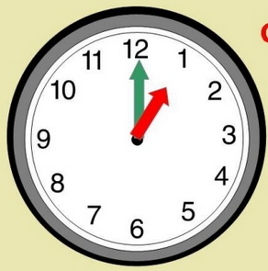
Vocabulary
An object that shows the time.
Clock
Sabina has a clock.

Slide 10
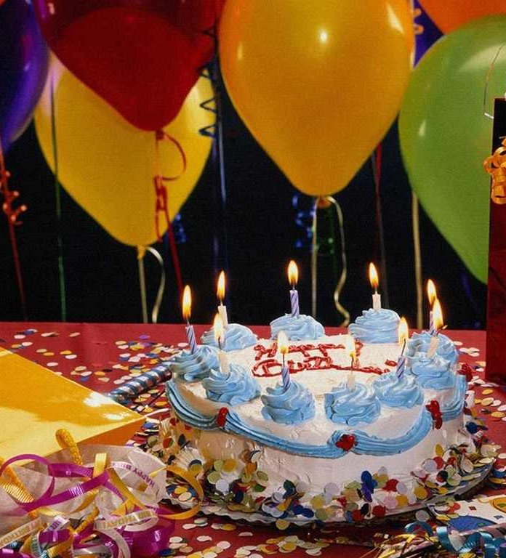
Vocabulary
This is the day when you were born.
Birthday
Her birthday is on 7th June.

Slide 11
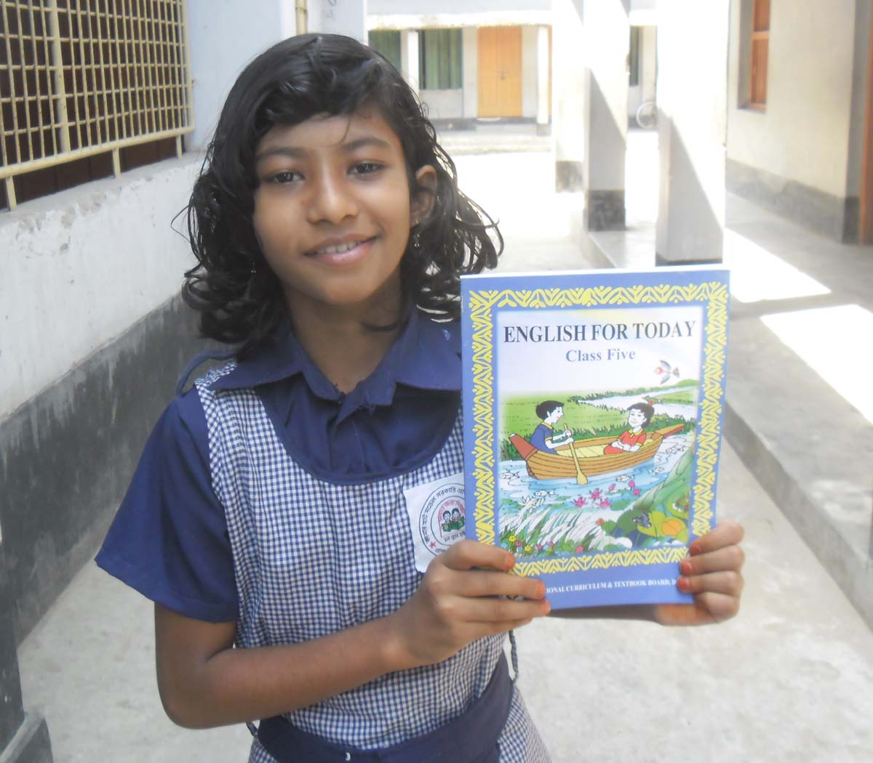
Vocabulary
To display something.
Show
The girl shows a book.

Slide 12
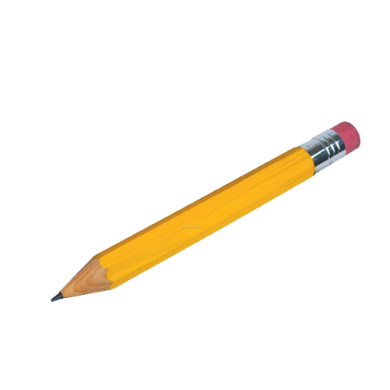
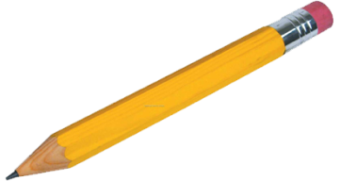
Vocabulary
Here is two pencils. One is long and another is short.
Long
Short
Long
Not short, a great length of time or space.
I like a long journey.
Short
Not full.
The man is too much short.

Slide 13

Loud Reading
Open your book at page 33.
Text Audio

Slide 14
The long hand is the minute hand.
The short hand is the hour hand.

Slide 15
60
5
There are 60 minutes on a clock face. Skip count by fives to count the minutes with me.
10
55
15
50
20
45
40
25
35
30

Slide 16
Count the numbers on the clock. There are only 12 hours on a clock face. So, the hour hand is a short hand.

Slide 17
“Minute” is a long word. The minute hand is the longer hand.
minute
“Hour” is a short word. The hour hand is the shorter hand.
hour

Slide 18
When the long hand is at twelve and the short hand is at a number, it shows an hour.

Slide 19
Look at the clock. The short hand is at one and the long hand is at twelve. It’s one o’clock.

Slide 20
Practice
Time: 15 minutes

Slide 21
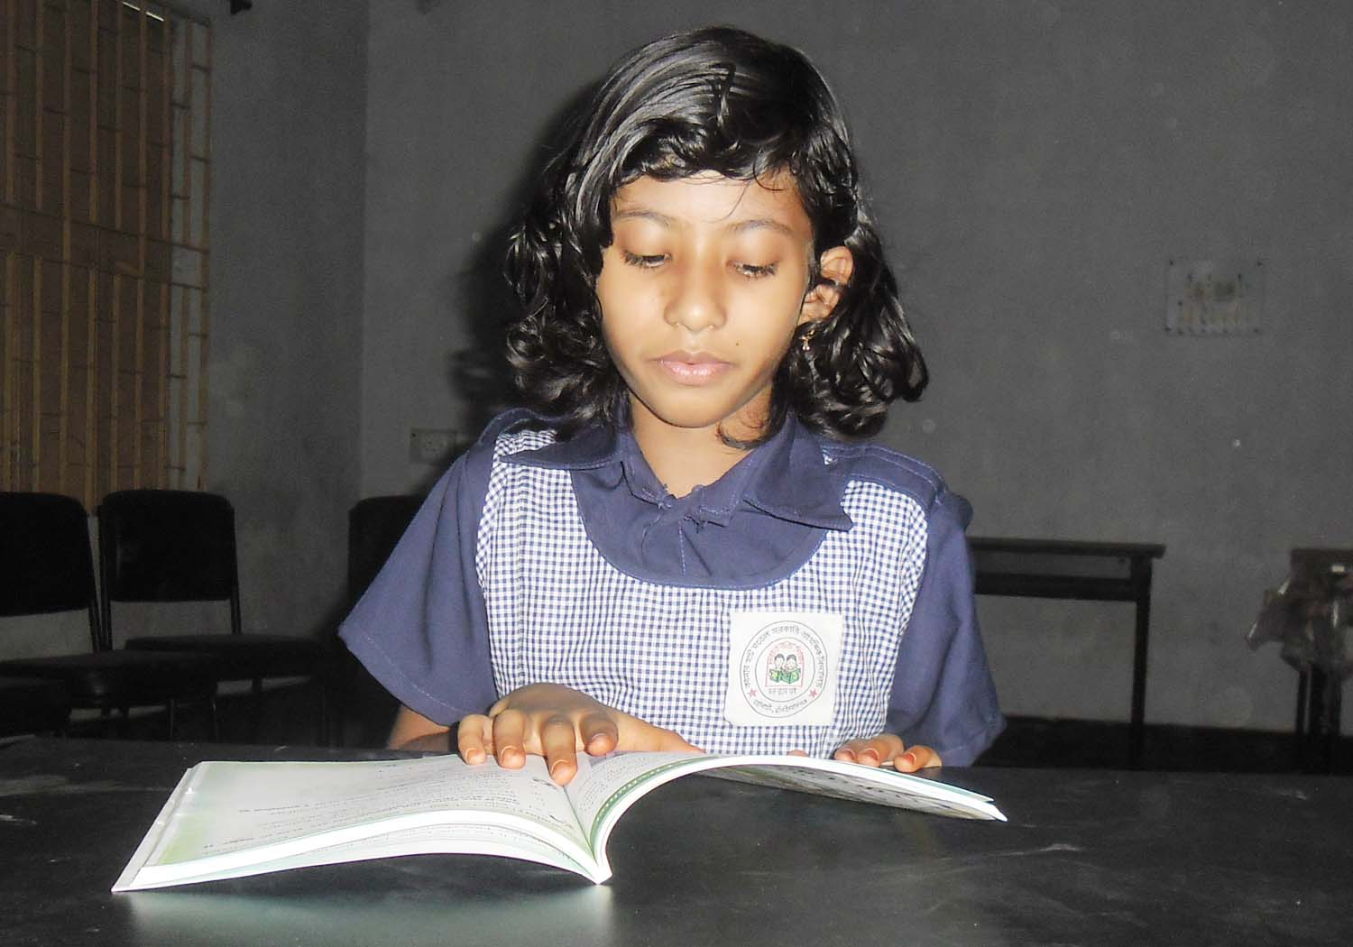
Silent Reading
Time: 5 minutes

Slide 22
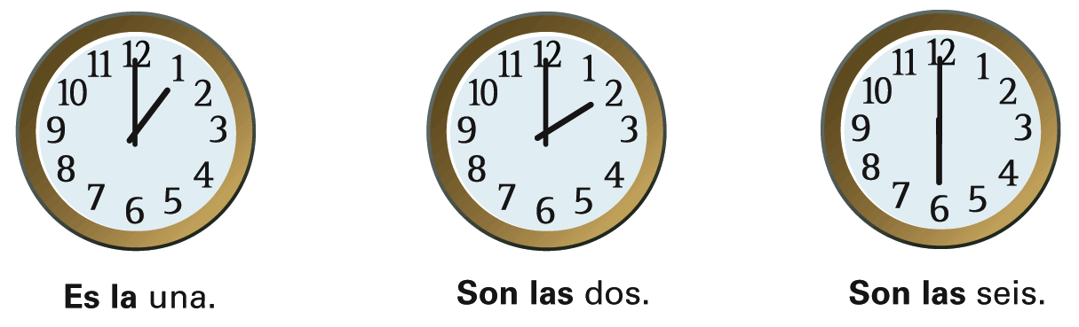
Look and say: PW # Time: 5 minutes
S1: What’s the time?
S2: It’s one o’clock.
1.
S1: What’s the time?
S2: It’s two o’clock.
2.
S1: What’s the time?
S2: It’s six o’clock.
3.

Slide 23
Look at the clocks and say/write the time: GW
Time: 5 minutes
It’s ....................
It’s ....................
It’s ....................
It’s ....................

Slide 24

http://www.sheppardsoftware.com/mathgames/earlymath/clock_shoot.htm

Slide 25
Checking Learning
Time: 5 minutes

Slide 26

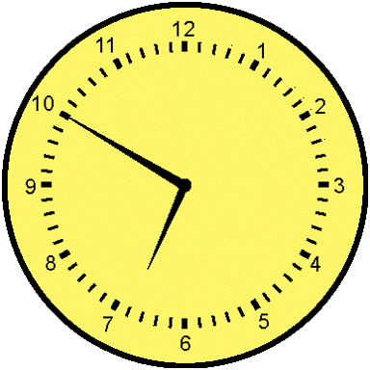
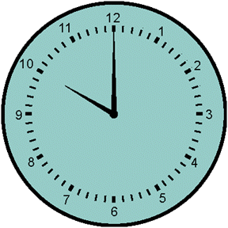
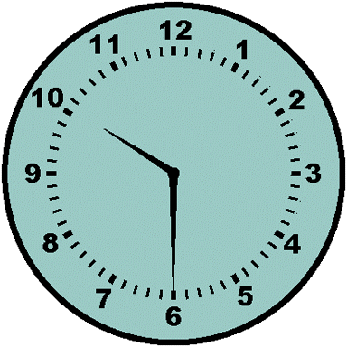
Find the clock that matches the time shown below.
It’s ten o’clock.
b.
a.
c.

Slide 27
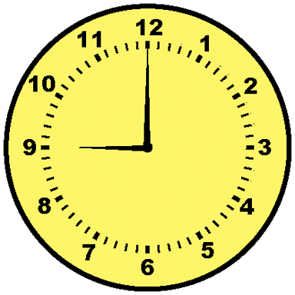
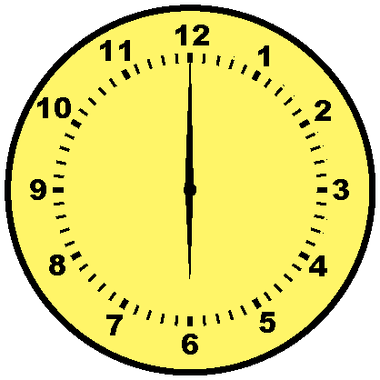
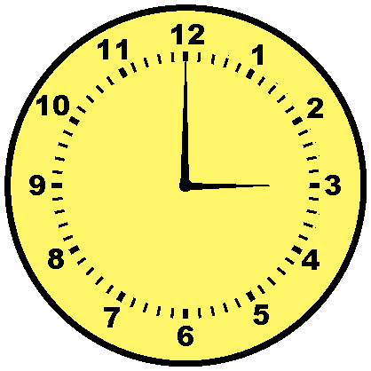
Find the clock that matches the time shown below.
It’s three o’clock.
b.
a.
c.

Slide 28
Find the clock that matches the time shown below.
It’s nine o’clock.
b.
a.
c.

Slide 29
Home work
Fill in the blanks:
01. I get up at ...... o’clock.
02. I have my breakfast at ...............
03. I start for school at ...............
04. My class begins at ...............

Slide 30

See you tomorrow

